Slide 1

Sales Performance Dashboard
Internship task 4 by
b.sharmilaa

Slide 2
Uses of Virtual Reality
Key Performance Indicators:
Total Sales: $X.XX Million
Total Profit: $X.XX Million
Profit Margin: XX.X%
Monthly Growth: X.X%
Top 3 Insights:
Western region leads performance with 35% of total revenue
Q4 shows strongest seasonal performance - 25% higher than quarterly average
Electronics category dominates product mix at 42% of sales
"An intuitive, data-driven platform for real-time business decision-making"

Slide 3
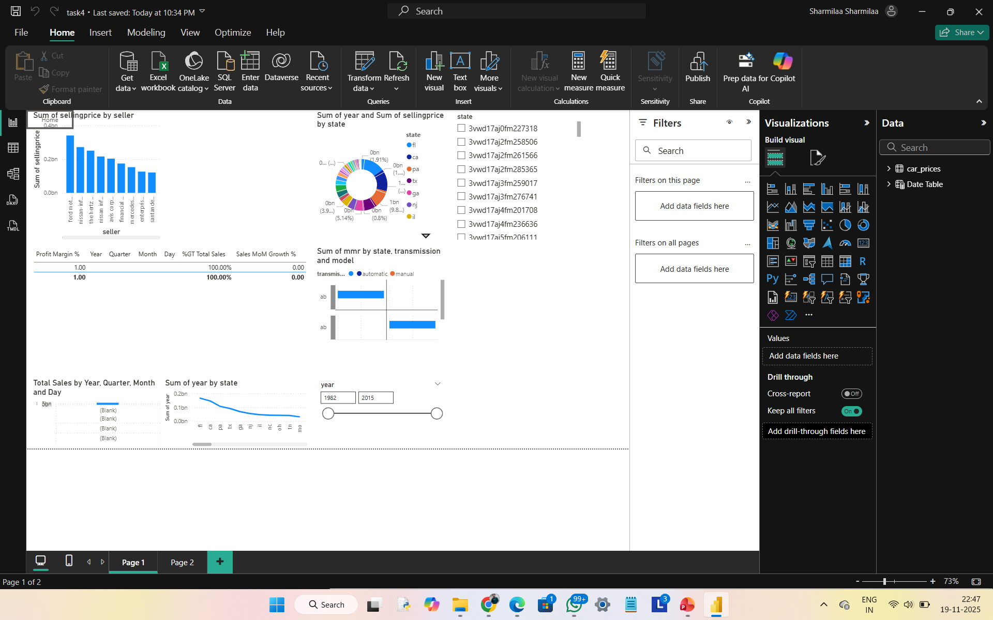
Dashboard Interface & Features
Annotated Sections:
🚀 Real-time KPI Cards - Key metrics at a glance
📈 Sales Trend Analysis - Time-series performance tracking
🗺️ Regional Performance - Geographic and category breakdowns
🎚️ Interactive Filters - Dynamic data slicing capabilities
🧭 Navigation Menu - Seamless multi-page exploration

Slide 4
Deep Dive: Data Visualizations
Visual 1: Sales Trend Analysis
Insight: Clear seasonal patterns with consistent Q4 peaks
Action: Optimize inventory planning for high-demand periods
Visual 2: Regional Performance
Insight: Western region outperforms others by 15%
Action: Investigate successful strategies for replication

Slide 5
User Guide & Interactivity
How to Use This Dashboard:
Filter by Time:
  Use Year slicer for annual view
  Date range selector for custom periods
Segment by Dimension:
  Region filter for geographic analysis
  Product category for portfolio review
Cross-Filtering:
  Click on any chart element to filter all visuals
  Example: Click "Western Region" to see product performance in that area
Multi-Page Navigation:
  Use left menu for detailed analysis pages
  "Back to Home" for quick return to overview

Slide 6
Technical Architecture
Data Pipeline:
Source: Excel Data Warehouse
Processing: Power BI Data Model
Output: Interactive Visual Analytics
Key Features:
✅ Star Schema Data Model
✅ DAX Measures & Calculations
✅ Time Intelligence Functions
✅ Responsive Design Layout
Refresh Schedule: Daily Automatic Updates
Tools & Technologies:
Microsoft Power BI Desktop
Power Query for ETL
DAX for Advanced Calculations

Slide 7
Value Delivery & Roadmap
Immediate Benefits:
Faster Decision-Making: Reduced analysis time from hours to minutes
Data Democratization: Self-service analytics for business teams
Performance Visibility: Real-time tracking of key metrics
Future Enhancements:
Predictive Analytics - Sales forecasting models
Customer Segmentation - Advanced cohort analysis
Mobile Optimization - Enhanced mobile experience
Automated Alerts - Threshold-based notifications

Slide 8

Thank You!

